Slide 1
Understanding Containers

Slide 2
Container
Build,Ship and Run anywhere

Slide 3
Why Containers ?
When a system consists of a small number of applications, it’s okay to assign a dedicated VM’s to each application and run each in its own operating system. But as the microservices become smaller and their numbers start to grow, you may not be able to afford to give each one its own VM if you want to keep your hardware costs low and not waste resources
Each VM typically needs to be individually configured and managed, which means that running higher numbers of VMs also results in higher staffing requirements and the need for a better, often more complicated automation system.
Due to the shift to microservice architectures, where systems consist of hundreds of deployed application instances, an alternative to VMs was needed. Containers are that alternative.
https://docker-from-scratch.ivonet.nl/docs/about.html

Slide 4
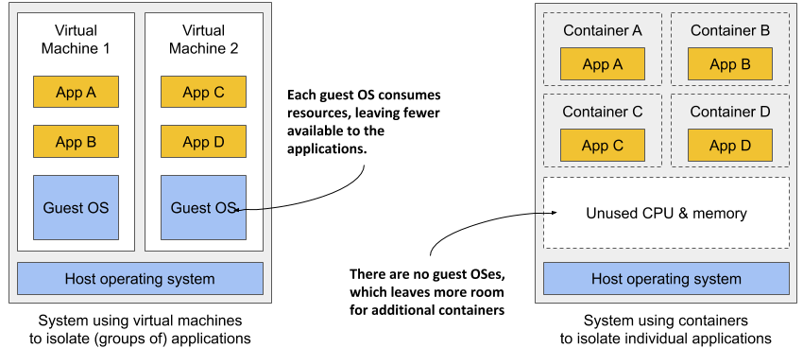
Virtual Machines vs Container

Slide 5
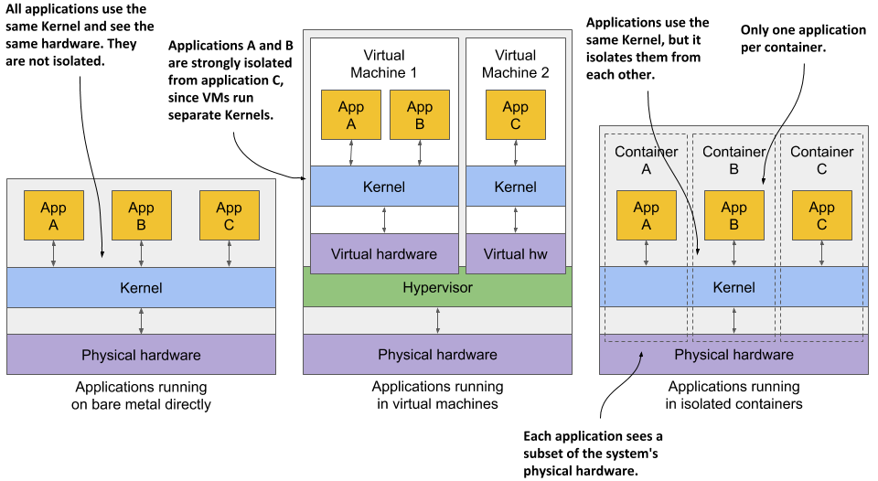
Bare Metal vs Virtual Machines vs Container

Slide 6
Container drawbacks
Containers all use the same kernel. This can clearly pose a security risk. If there’s a bug in the kernel, an application in one container might use it to read the memory of applications in other containers.
Containers share memory space, whereas each VM uses its own chunk of memory. Therefore, if you don’t limit the amount of memory that a container can use, this could cause other containers to run out of memory or cause their data to be swapped out to disk.

Slide 7


Slide 8
Docker Container
Build,Ship and Run anywhere

Slide 9
Overview
Docker was the first container that made them easily portable across different computers.
Docker is a platform for packaging, distributing and running applications.
It simplified the process of packaging up the application and all its libraries and other dependencies - even the entire OS file system - into a simple, portable package that can be used to deploy the application on any computer running Docker.
Docker allows you to distribute this package via a public repository to any other Docker-enabled computer.

Slide 10
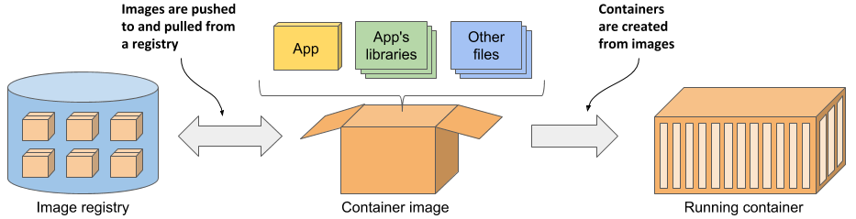
Docker Concepts
Images- A container image is something you package your application and its environment into. Like a zip file or a tarball.
Registries- A registry is a repository of container images that enables the exchange of images between different people and computers. After you build your image, you can either run it on the same computer, or push (upload) the image to a registry and then pull (download) it to another computer.
Containers- A container is instantiated from a container image A running container is a normal process running in the host operating system, but its environment is isolated from that of the host and the environments of other processes.

Slide 11
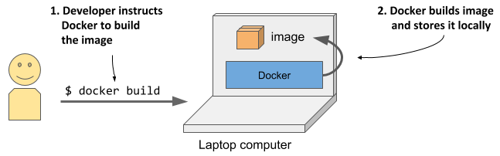
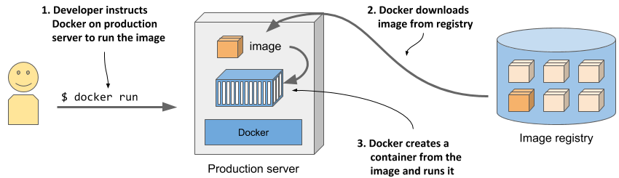
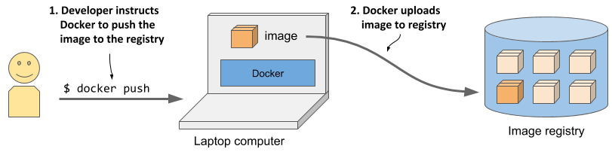
Build,Distribute and Run the Image
Three processes involves-
1
Building a container image
3
Running a container on a different computer
2
Uploading a container image to a registry

Slide 12
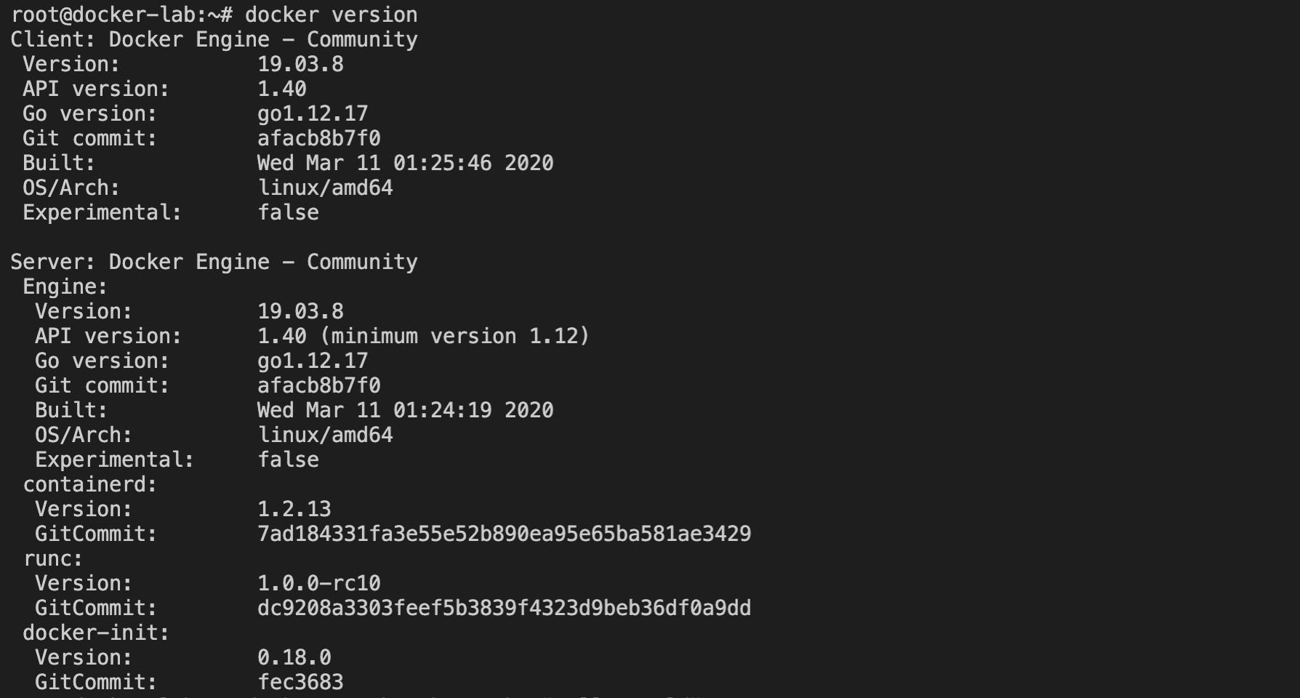
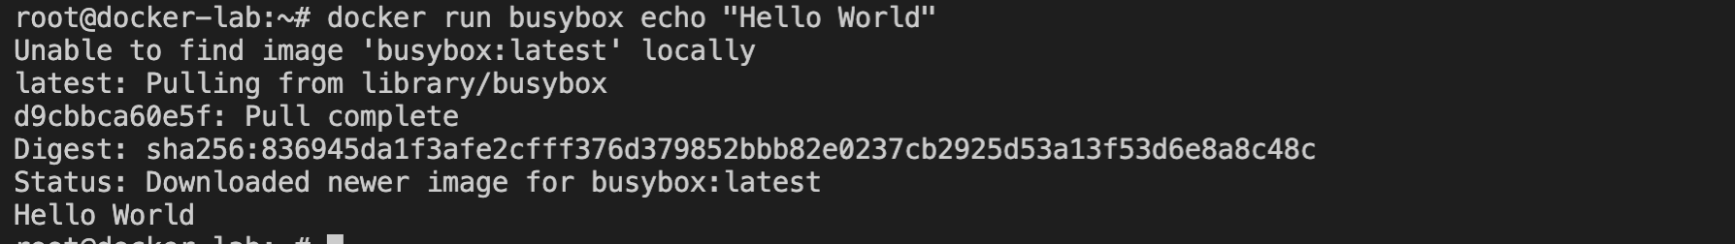
Hand-On
Create an application, package it into a container image and run it.
Installing docker and running a Hello World container

Slide 13
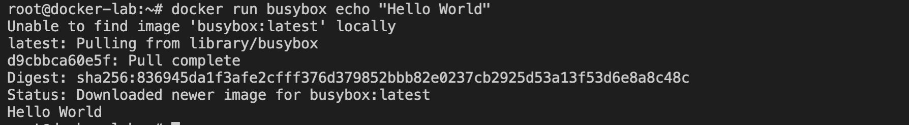
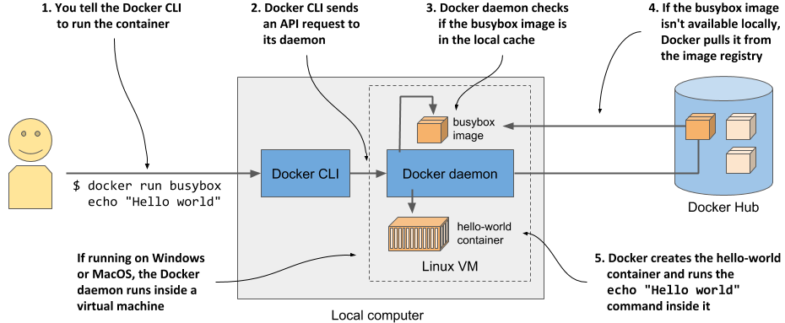
Running “Hello World” image

Slide 14
Lab- Create a containerized Web Application
# Create a Node.js web application and package it into a container image.The application will accept HTTP requests and respond with the hostname of the computer it’s running on.This way, you’ll see that an app running in a container sees a different hostname and not that of the host computer, even though it runs on the host like any other process.

Slide 15
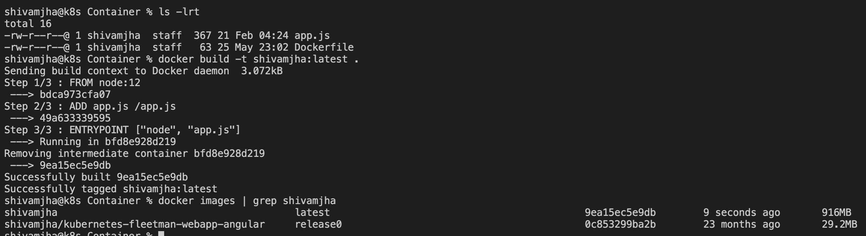
Lab- Create a containerized Web Application

Slide 16
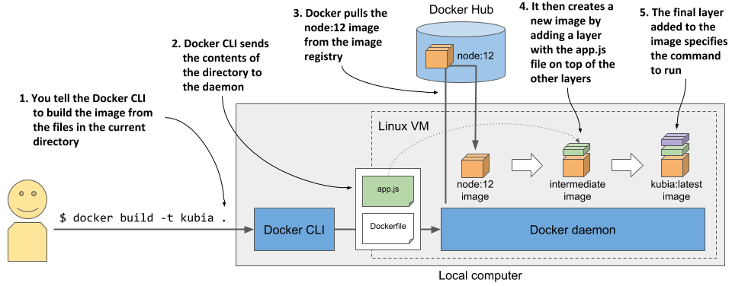
Lab- Create a containerized Web Application

